Slide 1
Outline
Setup and Configuration
Typical Workflow
Example Application
Available Resources

Slide 2
The Setup

Slide 3
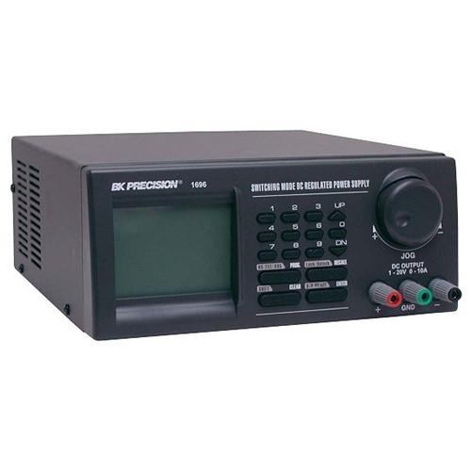
Setup: Power Supply
We utilize a BK Precision 1696 switchable power supply
Range and granularity of supported volts and amps falls into the right range for mobile devices and development platforms
Existing Python interface library from A. Sampson

Slide 4
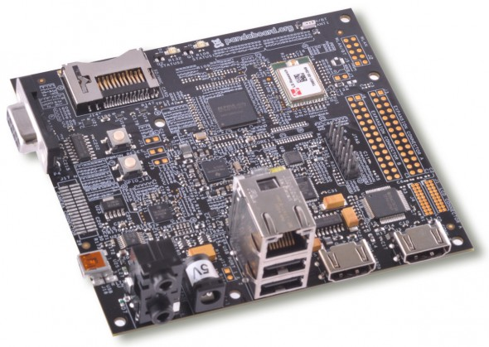
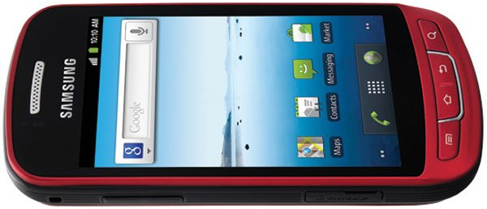
Setup: Pandaboard/Mobile Device
The main device we are utilizing is the Pandaboard
Embedded system/development platform resembling mid-range mobile phone specs
Multiple operating systems available, including Android
Directly connecting to the power supply
We also utilized the Samsung Admire lower-end smartphone
Utilizing the battery connectors after removing the battery

Slide 5
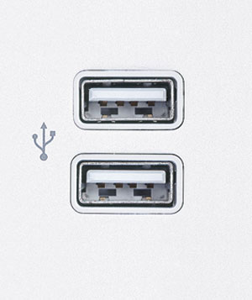


Setup: Measurement Computer
Any PC style computer would work in this setup, as well as laptops
Required are 2x free USB connectors (one for mobile device, one for power supply)
Android SDK installed (might require sudo access)
Python with libraries, esp. matplotlib (Linux/OSX preferred for ease of install)

Slide 6
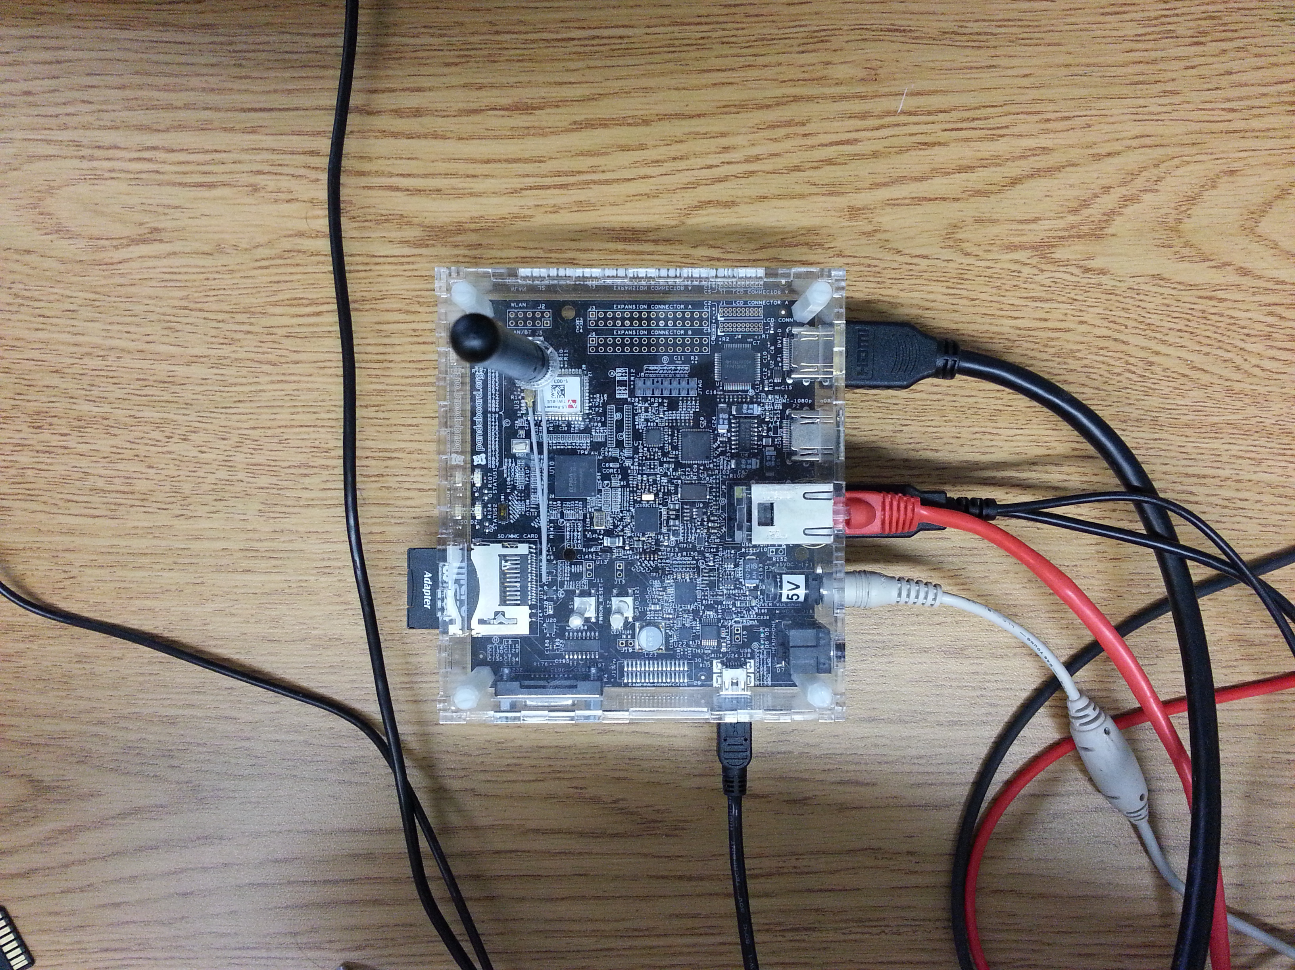
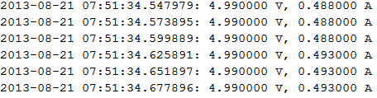
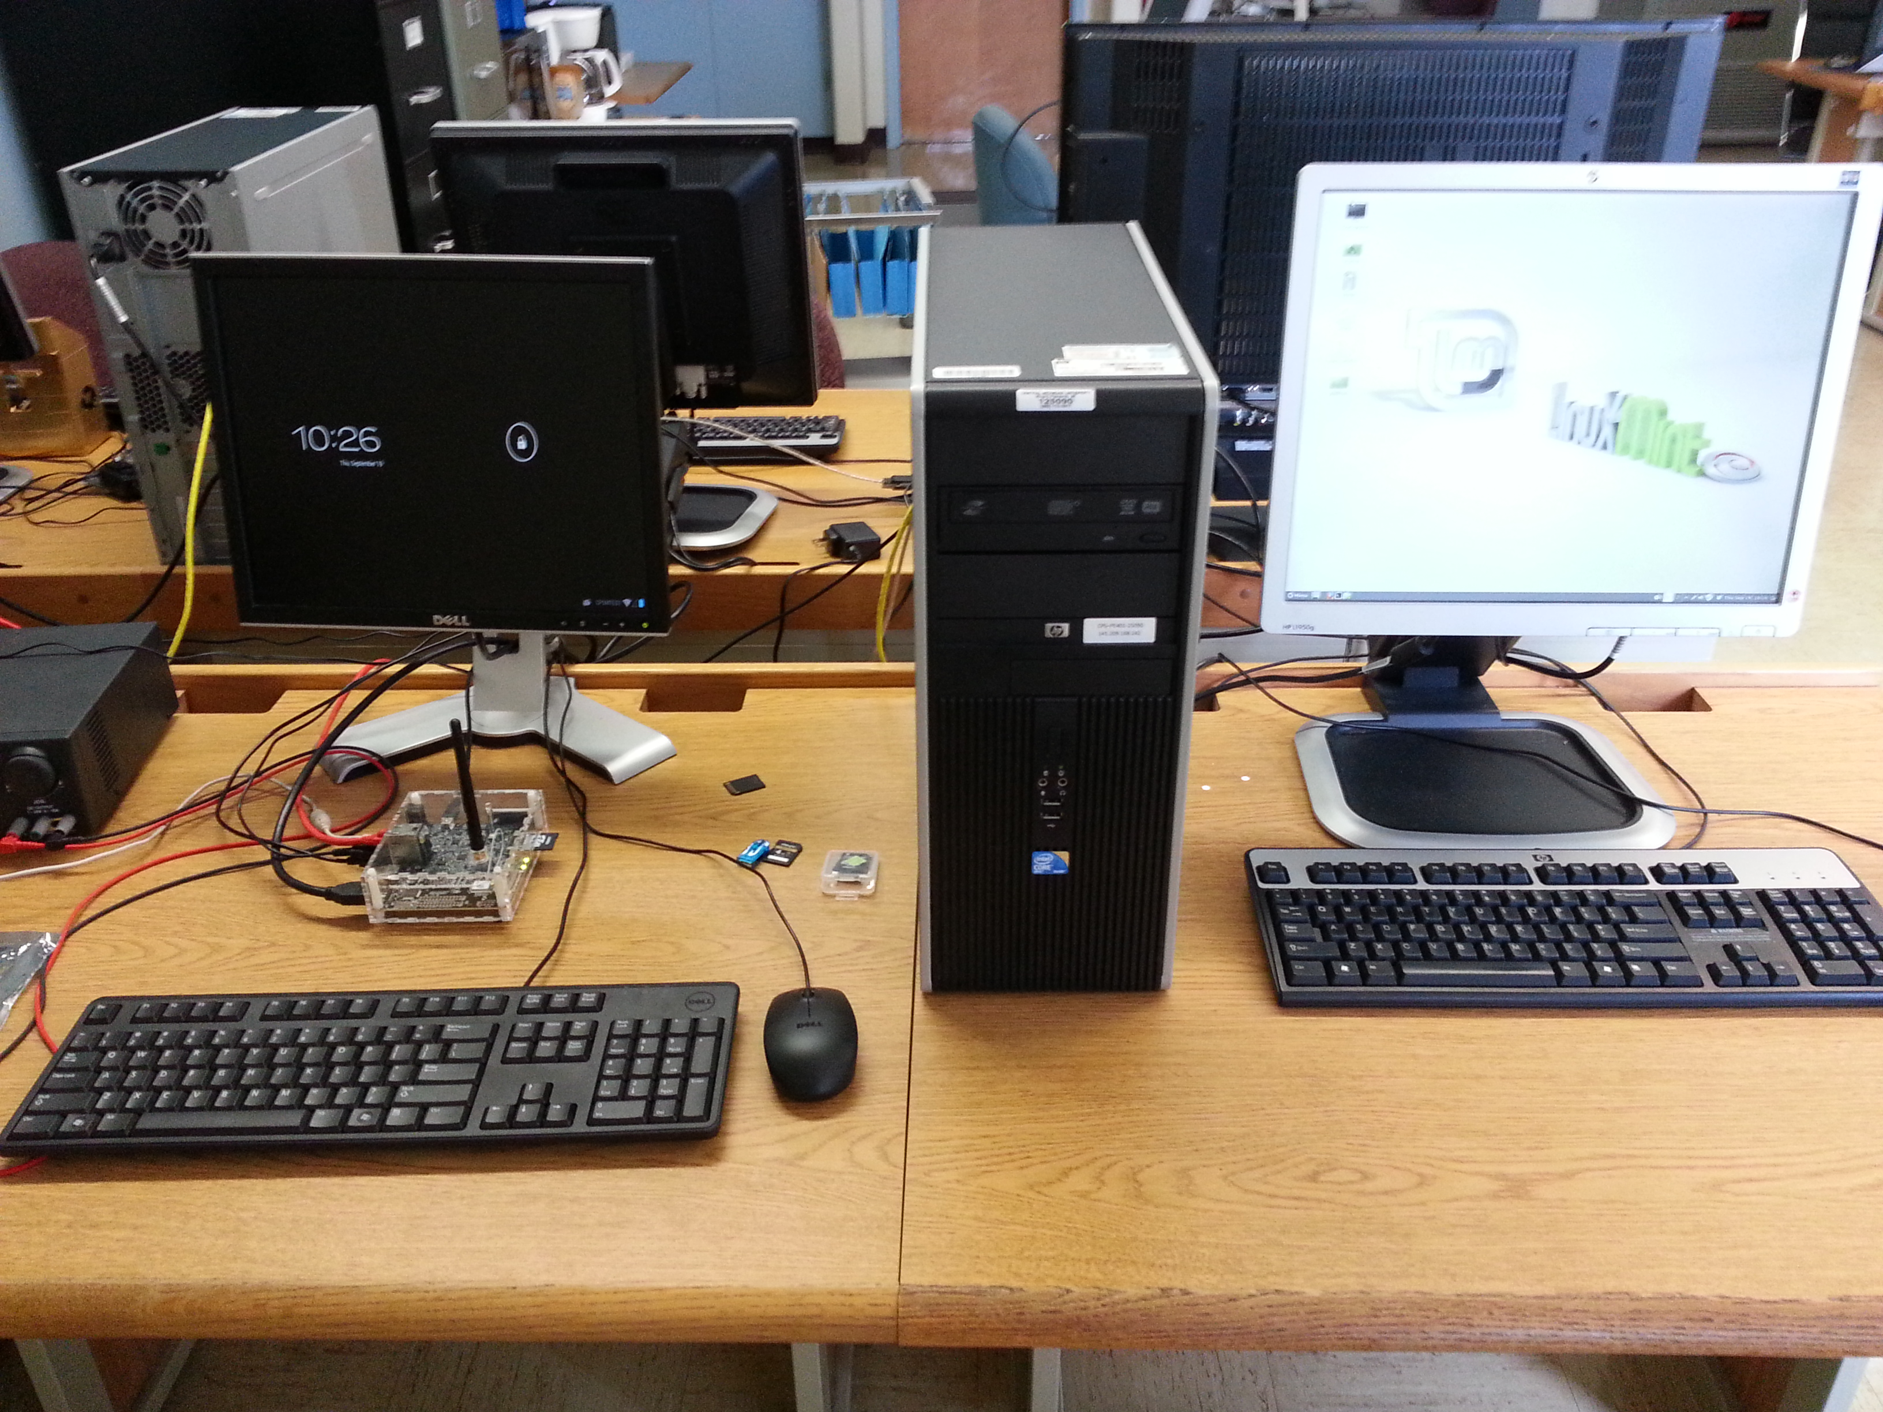
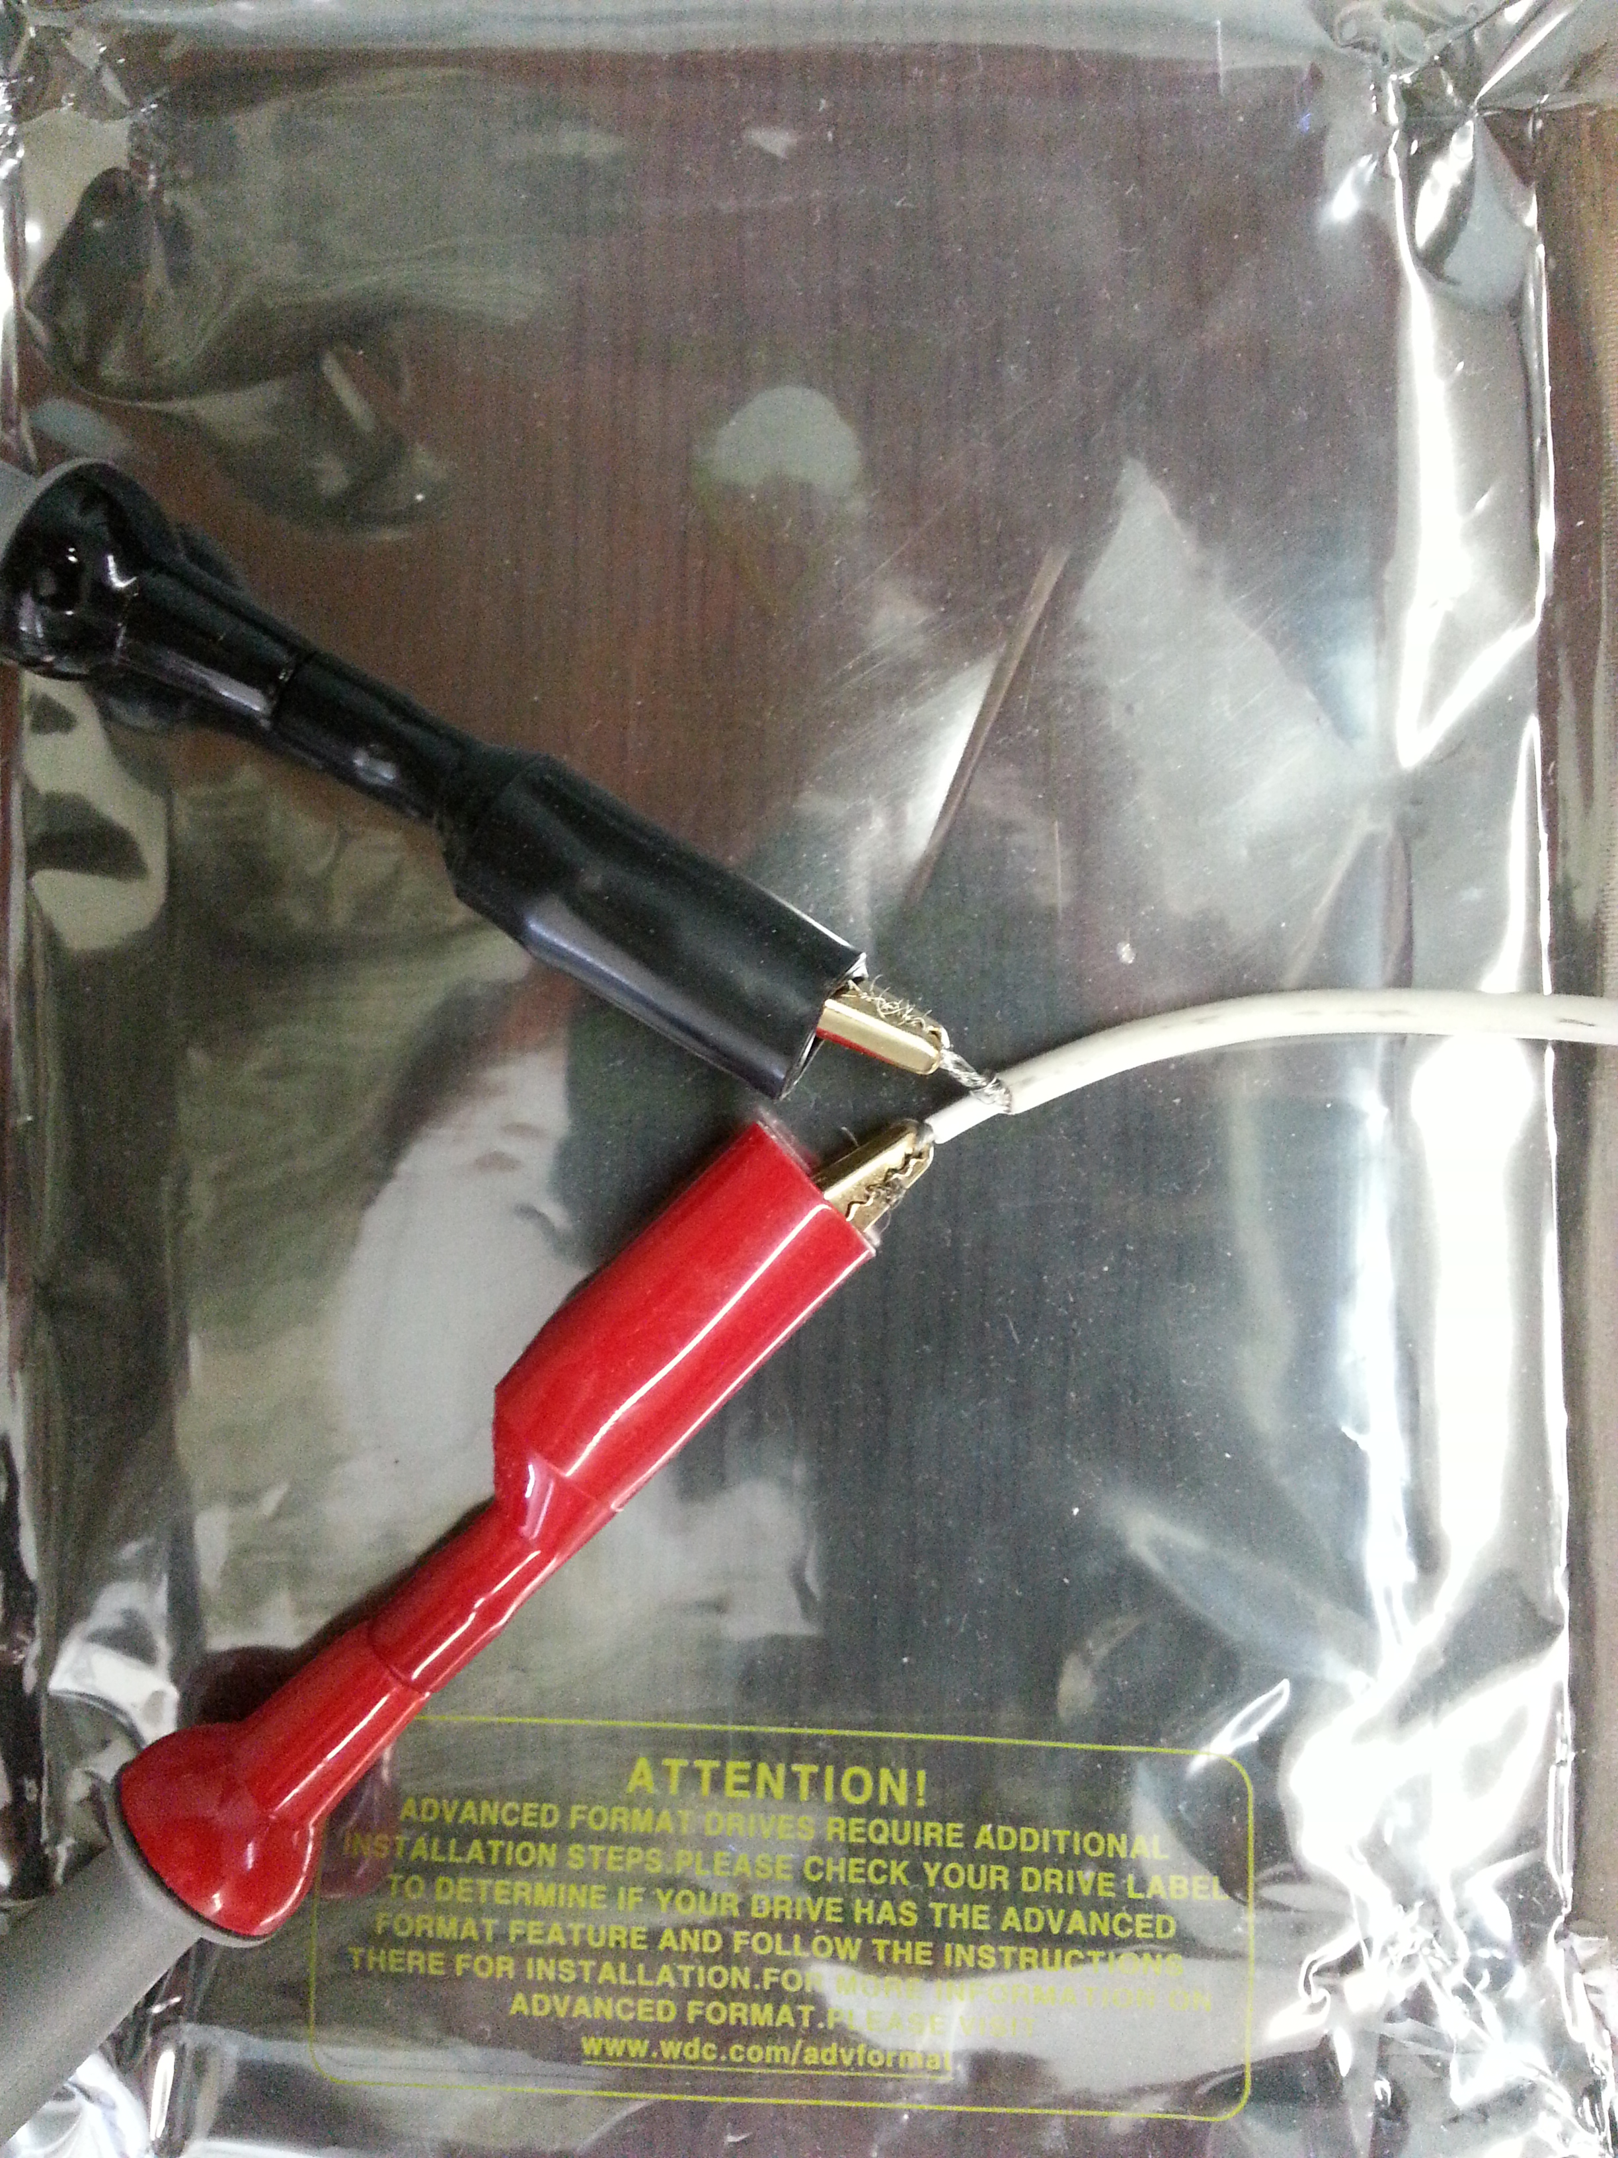
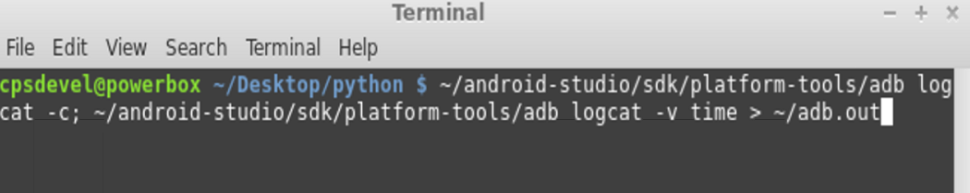
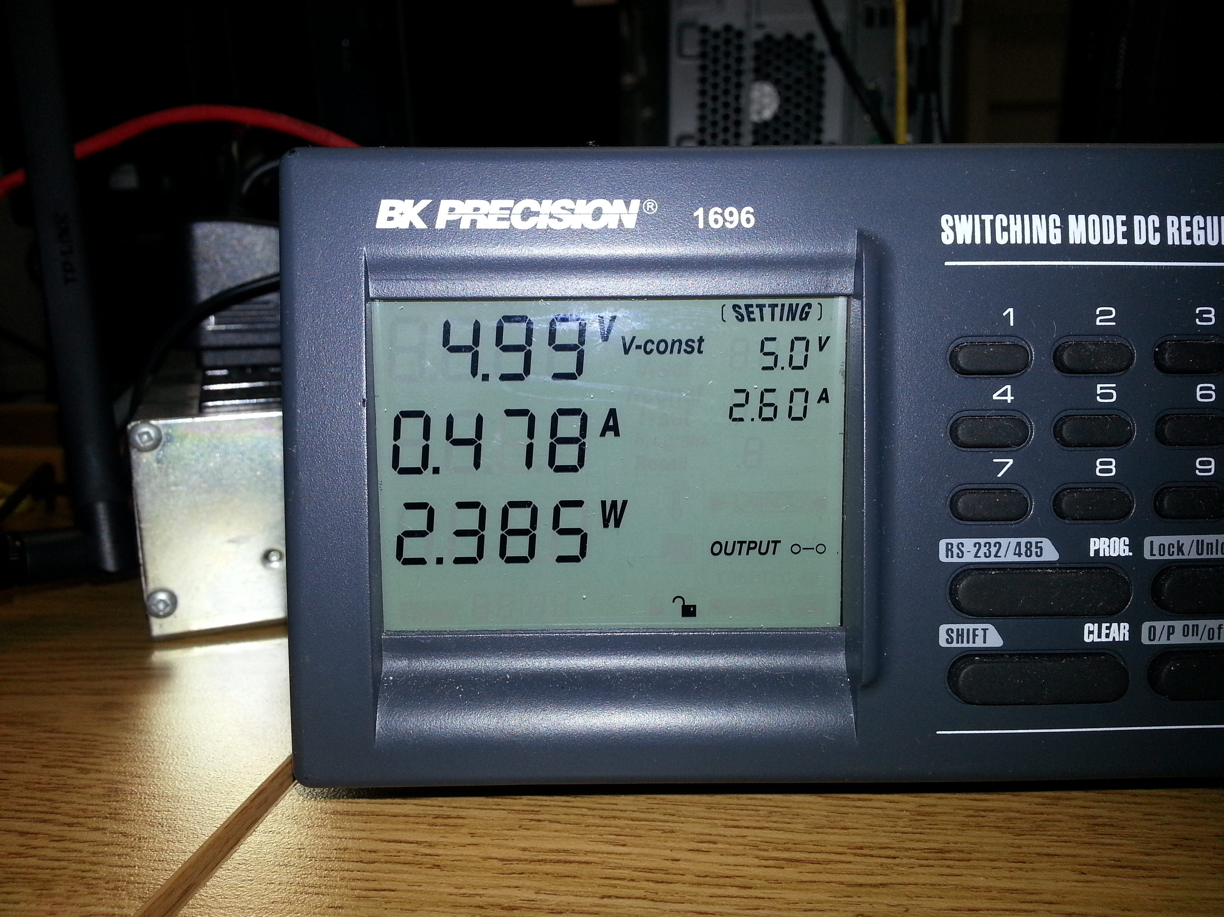
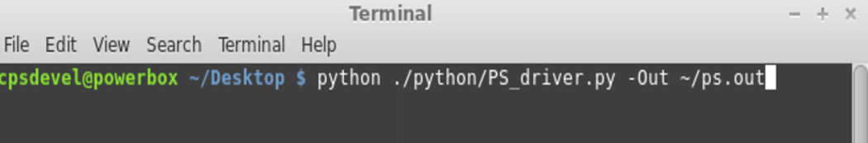
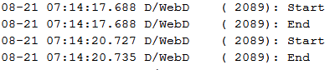
Workflow
USB for ADB
Power supply at the correct voltage level and enough current available to draw, e.g. for Pandaboard, we use 5V and 2.6A.
Cables connected
Application installed on mobile device (ADB or other)
ADB captures Android log output to file
Power supply script captures values to file
Execution of mobile application
Termination of scripts
Post-processing
SD-Card
with OS
Keyboard,
mouse,
LAN
HDMI to
display

Slide 7
Example Application: Comparing Downloads
Web page request:
Serial vs.Parallel
Mobile application
(Android)
Local Proxy Server
(Compress)
Local Web Server
(variants)

Slide 8
Example Application
Video segments:
1. setup explanation and starting the scripts
2. running the android application (web?)
3. stopping and post processing

Slide 9
Available Resources
We provide the scripts including short descriptions for direct implementation in your research projects.
On the web at cps-mobile.cmich.edu/???
Mirrored at http://patrick.seeling.org/demos/

Slide 10

Thanks for Watching!
Please contact us for further information.
Acknowledgement:
This work was sponsored by an Early Career Grant from the Office of Research and Sponsored Programs at Central Michigan University.

